Slide 1
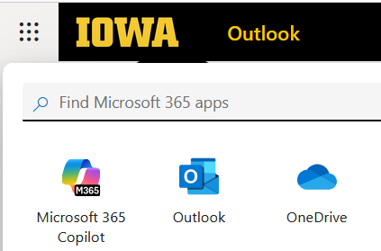
Using AI to Help Code
Since Python is popular programming language and there are lots of helpful message boards and data, most large language models (LLMs) work well to help with coding
We’ll try with Microsoft CoPilot

